Slide 1
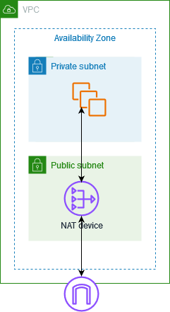
AWS NAT Gateway and NAT Instance
Presented by: Abhiram Reddy Date: May 16, 2025

Slide 2
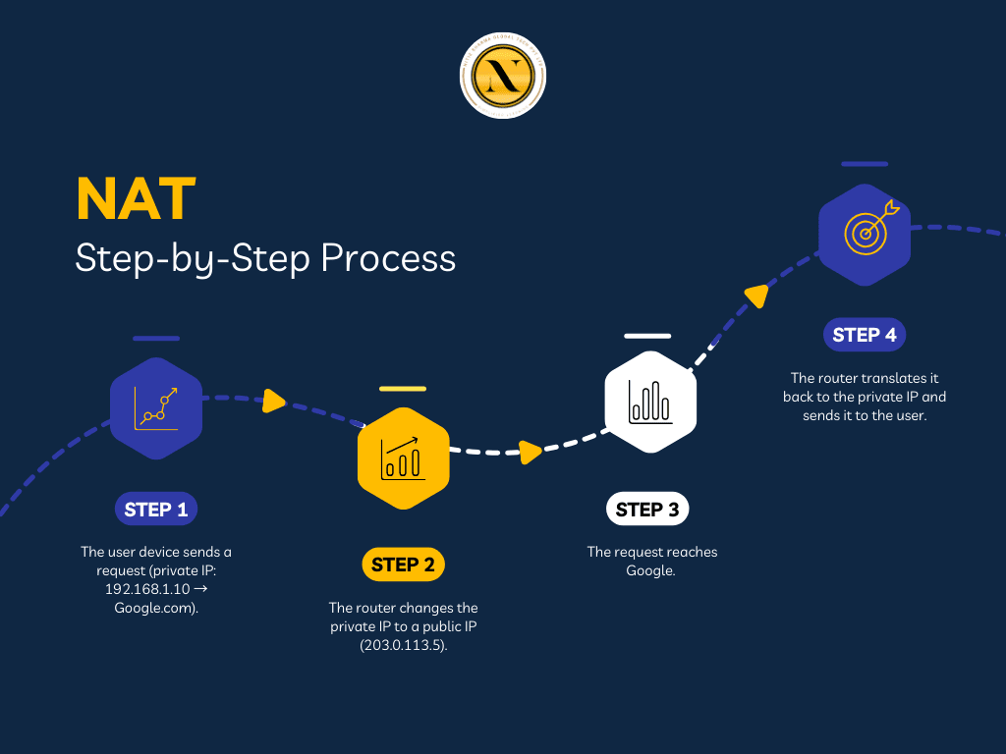
Table of Contents
What is NAT (Network Address Translation)?
Why NAT Matters in AWS
NAT Instance: Overview and Setup
NAT Instance: Pros & Cons
NAT Gateway: Overview & Features
NAT Gateway vs. NAT Instance: Comparison Table
When to Use Which

Slide 3
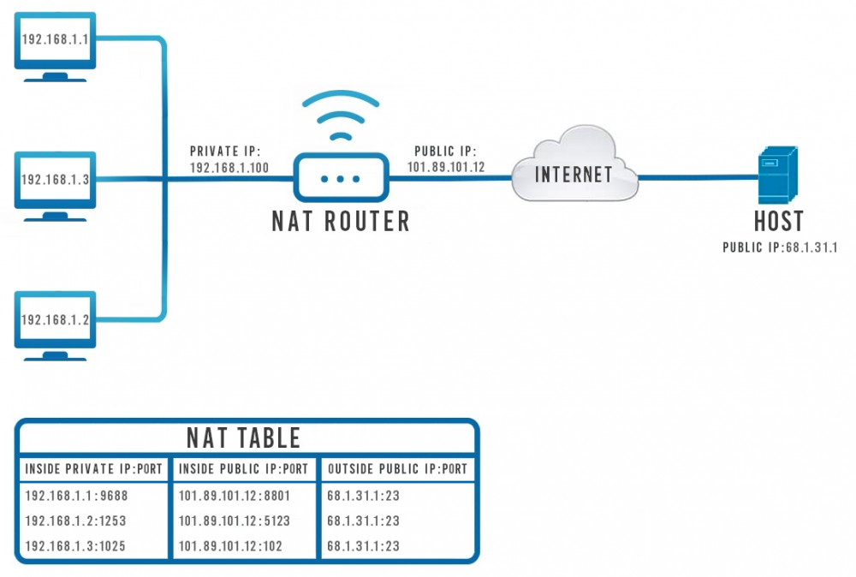
What is NAT (Network Address Translation)?
NAT is a networking technique that allows multiple devices on a private network to share a single public IP address.
Role in Networking: Translates private IP addresses to a public IP address for outbound traffic.
Use in Cloud Environments: Essential for enabling instances in private subnets to access the internet while remaining secure.
Benefit: Facilitates secure internet access for resources without exposing them directly to the public internet.

Slide 4
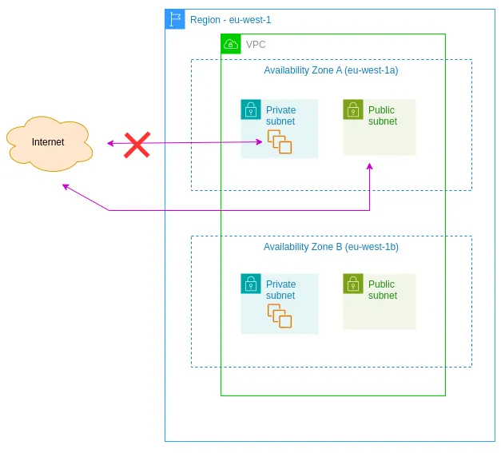
Why NAT Matters in AWS
In a typical AWS VPC (Virtual Private Cloud) structure:
Private and Public Subnets: Public subnets have direct internet access; private subnets do not.
Need for NAT: Allows instances in private subnets to initiate outbound traffic to the internet securely.
Support for Outbound Traffic: Ensures that resources can update, download packages, and access external services without being directly reachable from the internet.

Slide 5
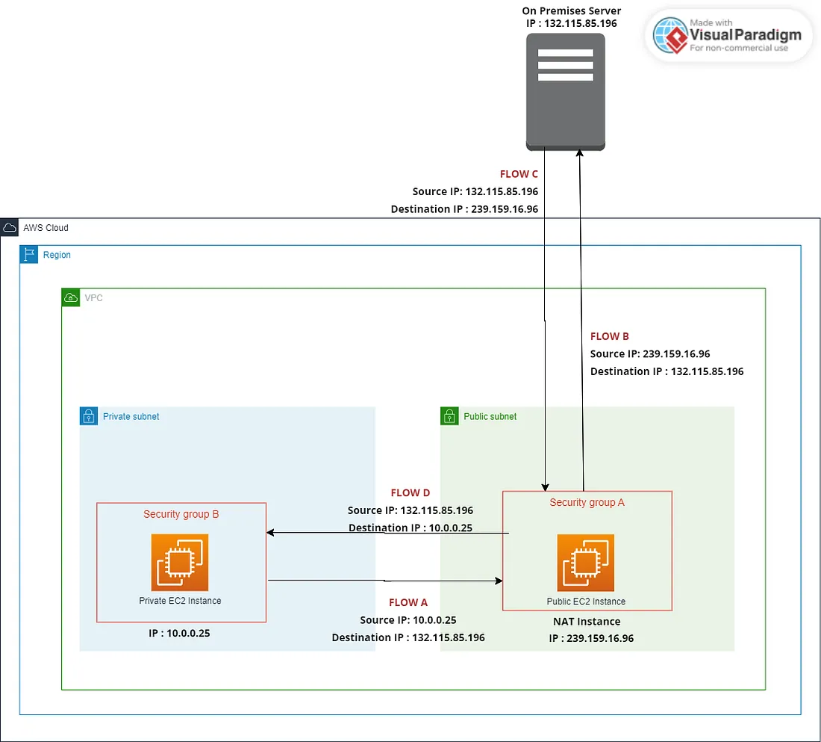
NAT Instance: Overview and Setup Part 1
A NAT Instance is an EC2 instance configured to perform NAT functions.
Initial Setup Steps:
Launch an EC2 instance in a public subnet.
Assign an Elastic IP to the instance for public access.

Slide 6
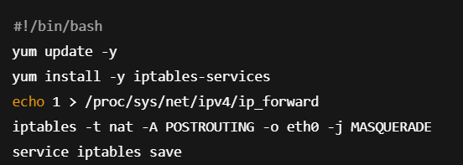
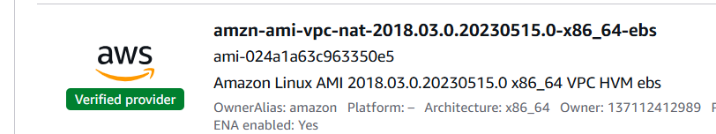
NAT Instance: Setup Part 2
Configure the EC2 Instance as a NAT Device:
Connect to the launched EC2 instance using SSH and your key pair.
Configure IP forwarding on the instance's operating system.
Set up iptables rules to perform Network Address Translation, specifically masquerading, which translates the source IP of packets from your private subnet to the public IP of the NAT instance.
We can also use NAT AMI for a instance.
Configure the security group of the NAT instance to allow only traffic from the VPC’s private subnets
Inbound - HTTP(80) HTTPS(443) from private subnet

Slide 7
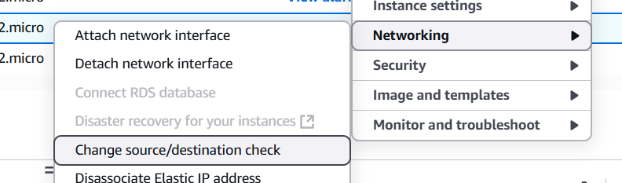
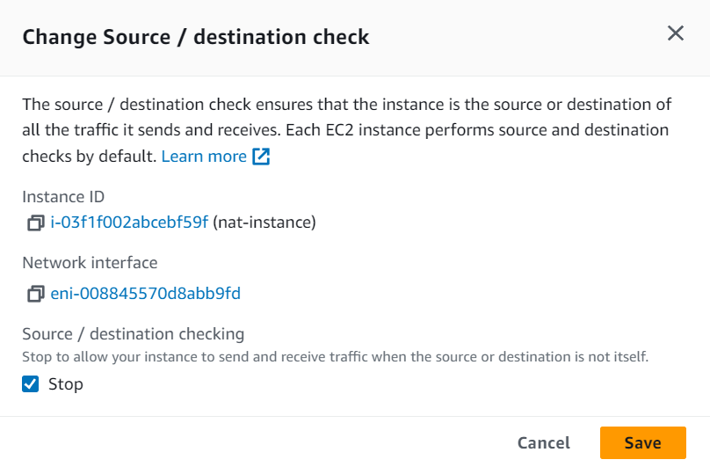
NAT Instance: Setup Part 3
Disable Source/Destination checks to allow NAT functionality.
After our instance is made we do this
By default, every EC2 instance performs a Source/Destination Check. This is a security measure. It means the instance checks if the source or destination IP address of any network packet it sends or receives is its own IP address
A NAT Instance's entire purpose is to send and receive network traffic on behalf of other instances (the instances in the private subnet).

Slide 8
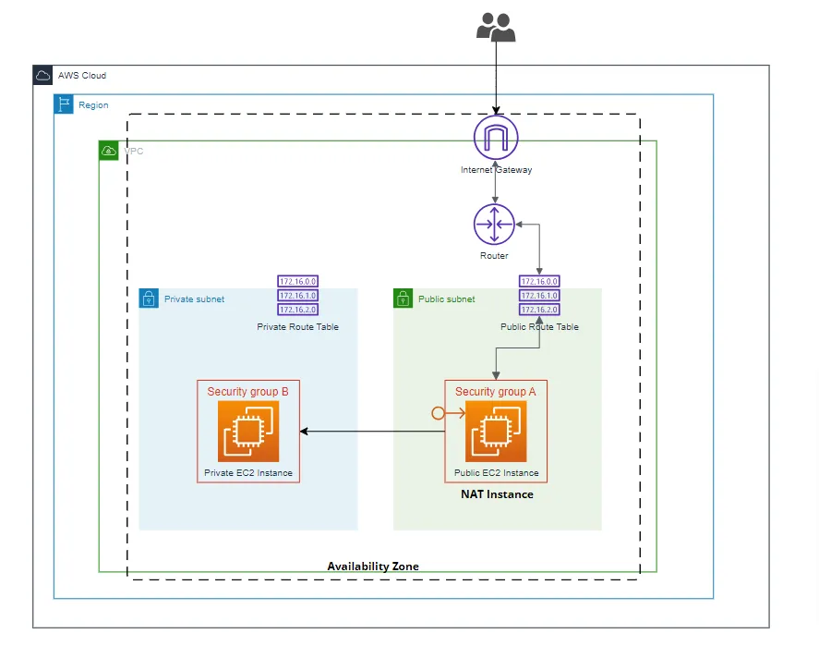
NAT Instance: Setup Part 4 – Route Table Configuration
The route table for the private subnet plays a critical role in NAT functionality:
Route Configuration: The route for 0.0.0.0/0 must direct traffic to the NAT Instance.
Importance: Without this route, internet-bound traffic will fail or be misrouted.
Correct Routing: With the proper route, packets are sent to the NAT Instance and then through the Internet Gateway for external access.
Setting up a NAT Instance is a hands-on process involving EC2 instance configuration and network rule management, while setting up a NAT Gateway is a few clicks

Slide 9
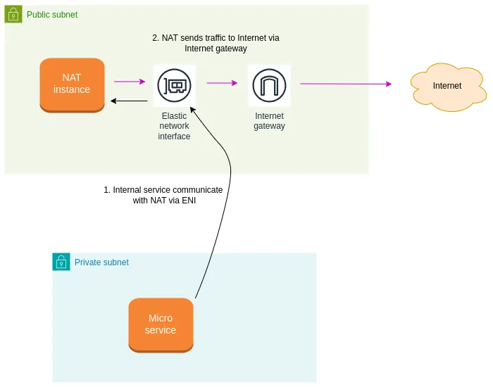
NAT Instance: Pros & Cons
Pros:
Flexibility: Can run custom software
Control: Full control over configuration and management.
Cons:
Manual Management: Requires regular patching and updates.
Scaling Challenges: Must be manually scaled based on traffic.
Availability: Single point of failure unless configured in a highly available architecture.

Slide 10
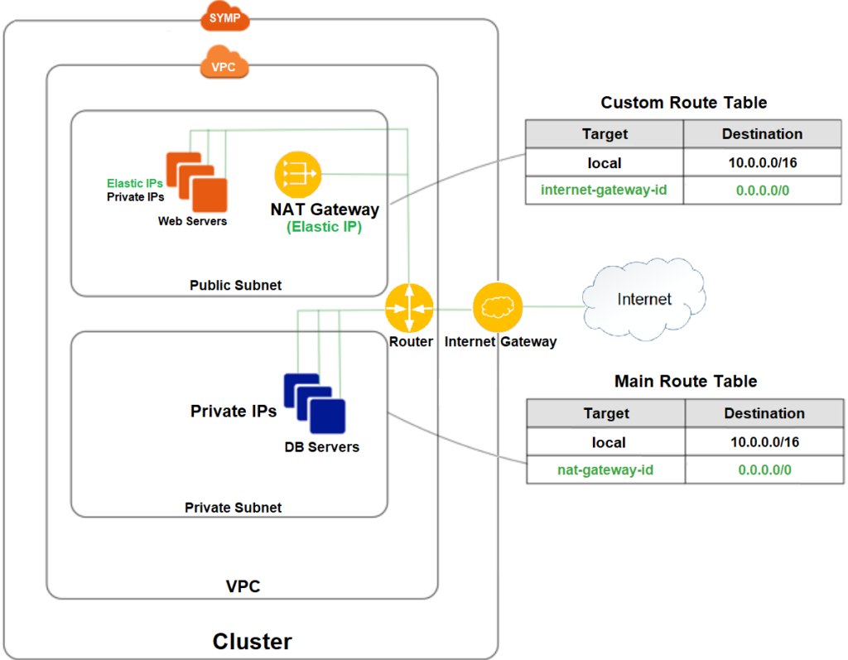
NAT Gateway: Overview & Features
A NAT Gateway is a managed service that simplifies NAT operations:
Managed Nature: AWS handles scaling and availability.
Automatic Scaling: Adjusts capacity based on traffic demands.
Elastic IP Requirement: Requires an Elastic IP for public access.
Limitations: Does not support custom software or dual-use as a Bastion Host.

Slide 11

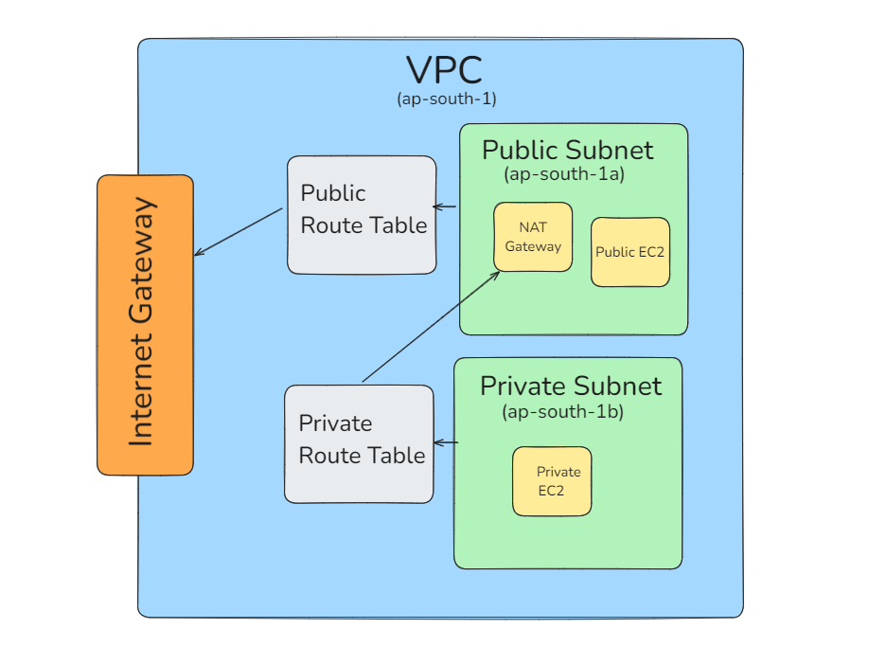
NAT Gateway Setup Configuration
To set up a NAT Gateway, follow these steps:
Create a NAT Gateway in a public subnet and Allocate and attach an Elastic IP
Ensure proper subnet and route settings are configured
For routing and availability:
Configure the private subnet route table to point 0.0.0.0/0 to the NAT Gateway
Implement AZ-specific setups and best practices for multi-AZ configurations to enhance availability

Slide 12
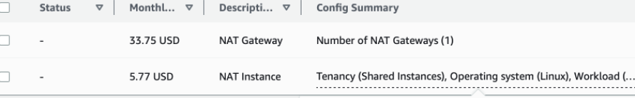
NAT Gateway vs. NAT Instance: Comparison Table
Feature | NAT Instance | NAT Gateway
Management | Manual | Managed
Scaling | Manual | Automatic
Availability | Single point of failure | High availability
Cost | Potentially lower | Higher cost
Performance | Variable | Consistent
Setup Ease | More complex | Easier
Bastion Support | Yes | No
Notes:
| Feature | NAT Instance | NAT Gateway |
| --- | --- | --- |
| Management | Manual | Managed |
| Scaling | Manual | Automatic |
| Availability | Single point of failure | High availability |
| Cost | Potentially lower | Higher cost |
| Performance | Variable | Consistent |
| Setup Ease | More complex | Easier |
| Bastion Support | Yes | No |

Slide 13
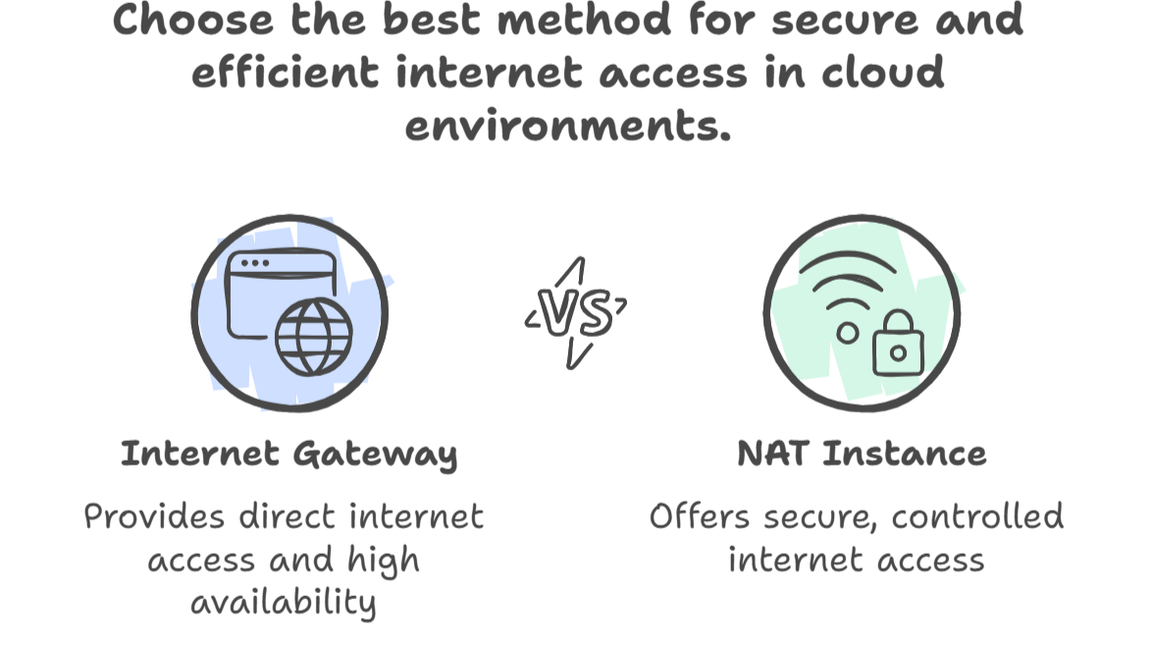
When to Use Which
Criteria for Choosing:
Traffic Levels: Use NAT Gateway for high traffic; NAT Instance for low to moderate.
Cost Considerations: NAT Instance may be more cost-effective for small workloads.
Scaling Needs: Choose NAT Gateway for automatic scaling; NAT Instance for custom configurations.
Custom Requirements: Opt for NAT Instance if custom software is needed.

Slide 14
Conclusion
NAT Gateways were introduced by AWS in December 2015. They came about directly as a response to the challenges and operational overhead associated with the previous method, which was manually setting up and managing NAT Instances.

